Slide 1
AI and Data Analytics for Governance: Improving Public Sector Efficiency Through Automation
Guided by :
Dr. krishna Bhagawan bandaru
Submitted by :
Aayush sahu
Ajay krishnanad paikra
Amisha chandel
Ayush Kashyap
Ayush verma

Slide 2
introduction
Context:
The insurance industry is dealing with an increasing volume of claims and unstructured data in the form of claim forms, legal documents, and contracts.
Traditional manual processing methods are no longer efficient, leading to high operational costs, delays, and potential errors.
Relevance of the Project:
Digital transformation is critical for improving operational efficiency and reducing costs in sectors like insurance and legal processing.
AI-driven automation, particularly using GenAI and NLP, offers a powerful solution to streamline document processing and create a competitive edge.
Why Now?:
The market is increasingly looking for digital transformation solutions to cut operational costs, improve accuracy, and speed up customer response times. This project aims to address these needs with innovative AI technologies.

Slide 3
The Problem & Value Proposition
Current Pain Points (As-Is State):
Manual review of insurance claims or legal documents is slow, with high costs and human error.
Processing large volumes of unstructured data is inefficient and prone to inconsistencies.
Requires significant resources (FTE) for data extraction and classification.
Cost/Time/Risk:
Average time per claim form: 12 - 15 minutes (manual processing).
High operational costs
Risk of errors leading to costly legal implications.
Value Proposition of Digital Transformation:
FTE Savings: Reduces the number of people required for document review.
Time Efficiency: Accelerates the process from hours to minutes per claim.
Accuracy: Minimizes human error, ensuring higher accuracy in classification and data extraction.

Slide 4
Digital Solution & PoC Demo
High-Level Description of the Chosen Technology:
We leverage Generative AI (GenAI) and Natural Language Processing (NLP) to automate the extraction and summarization of key data points from unstructured documents.
Using Hugging Face APIs and ollama models for easy deployment and scalability.
PoC Demo:
Demonstration: Showcase a live demo or recorded video of the AI extracting 3-5 key entities from a sample insurance claim document.
Entities to extract: Claim ID, Customer Name, Claim Amount, Date of Incident, and Incident Description.

Slide 5
System Architecture & Technology Stack
System Design Diagram: Include a diagram that demonstrates:
Input Layer: Document intake (e.g., scanned PDFs, images).
Processing Layer: NLP/GenAI model for extraction and classification.
Output Layer: Structured data output (JSON, CSV) for downstream processes (e.g., insurance processing systems).
Technology Justification:
Localhost Deployment
APIs (Hugging Face/ ollama model ): Easy integration with existing systems and quick deployment for NLP tasks.
Chroma DB Storage: Secure and scalable data storage for input/output documents.

Slide 6
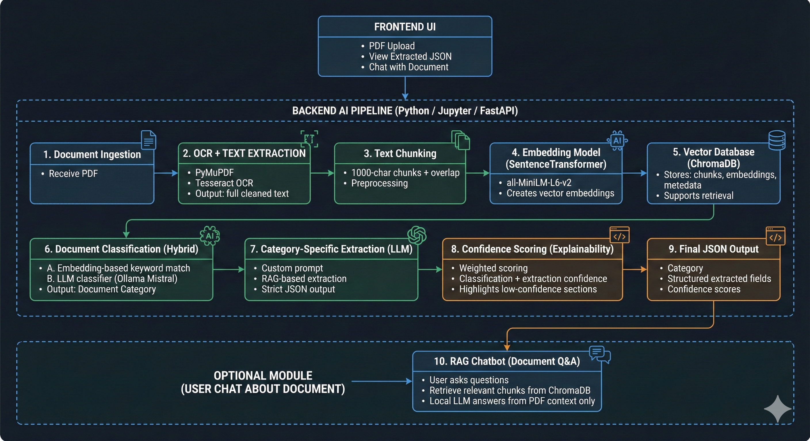
SYSTEM FLOWCHART

Slide 7
Business Impact & ROI
Expected Savings:
FTE Savings: Automating the process can save 7 FTEs annually, resulting in a savings of time.
Processing Time Reduction: Reduces document processing time by 75 - 80%, leading to faster decision-making and improved customer service.
Accuracy Improvement: AI model improves accuracy by reducing errors by 80%.
KPIs for Project Success:
FTE Savings: Measure the number of FTEs saved post-implementation.
Processing Time: Track the average time per claim before and after automation.
Accuracy Rate: Percentage reduction in manual errors.
Cost Reduction: Financial savings due to reduced operational costs.
Customer Satisfaction: Improvement in customer service response time.

Slide 8
Implementation Roadmap & Risks
Implementation Phases:
Pilot: Test AI automation with a small sample of claims to evaluate performance.
Scale: Gradually expand to handle larger volumes of claims.
Global Rollout: Full deployment across all insurance claim processing workflows.
Top 3 Risks:
Data Privacy: Ensure compliance with privacy regulations (e.g., GDPR).
Mitigation: Implement strong encryption and data anonymization techniques.
User Adoption: Employees may resist the change.
Mitigation: Provide comprehensive training and change management programs.
Cloud Costs: High infrastructure costs for large-scale operations.
Mitigation: Optimize serverless usage and cloud resource scaling.

Slide 9
Change Management Strategy
User Training:
Provide hands-on training sessions for employees to become proficient in the new system.
Offer support materials such as video tutorials, FAQs, and a helpdesk.
Organizational Shift:
Encourage buy-in from key stakeholders by emphasizing the benefits of automation.
Set up a feedback loop to refine the AI model and its integration into daily workflows.

Slide 10
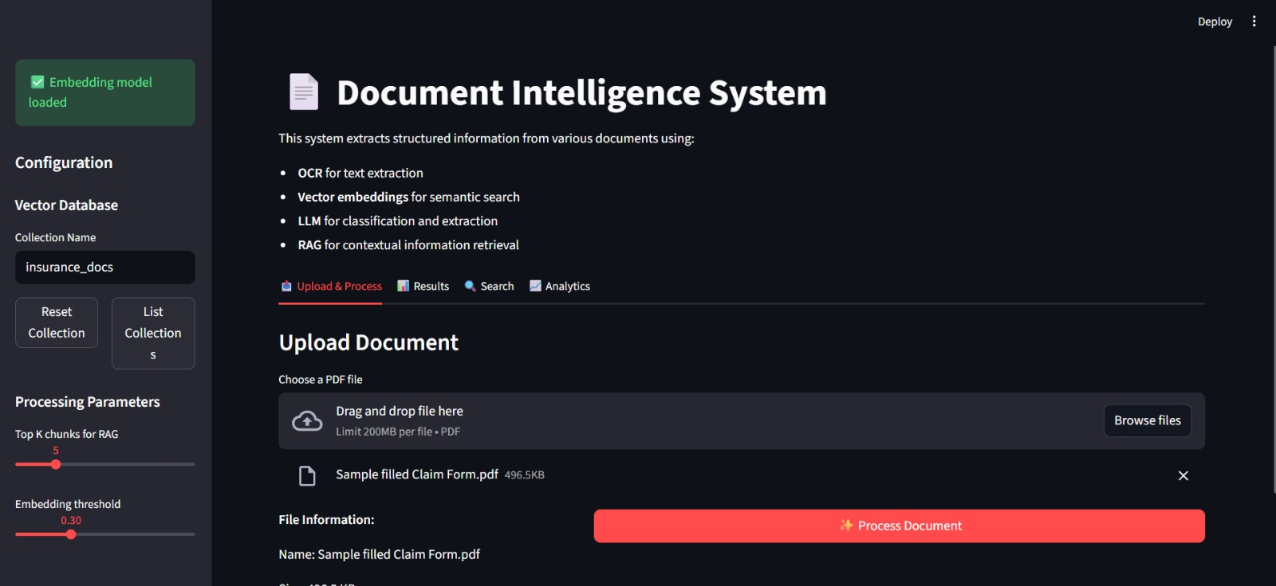
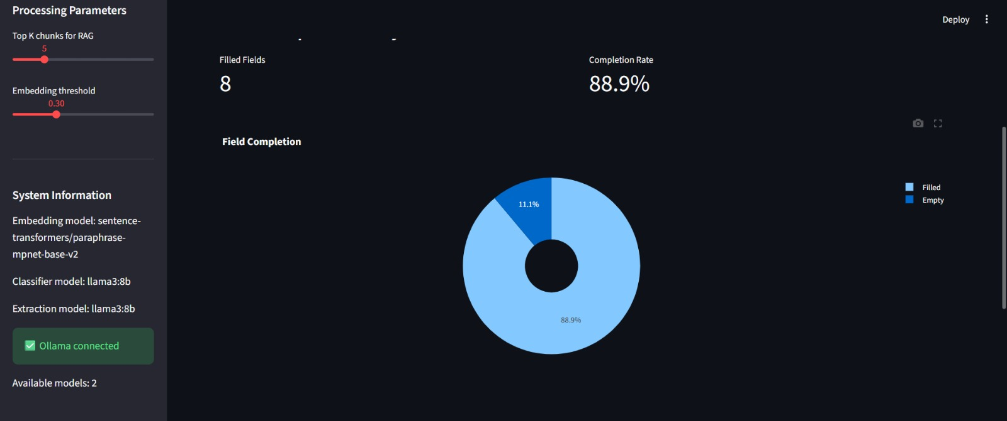
OUTPUTS

Slide 11
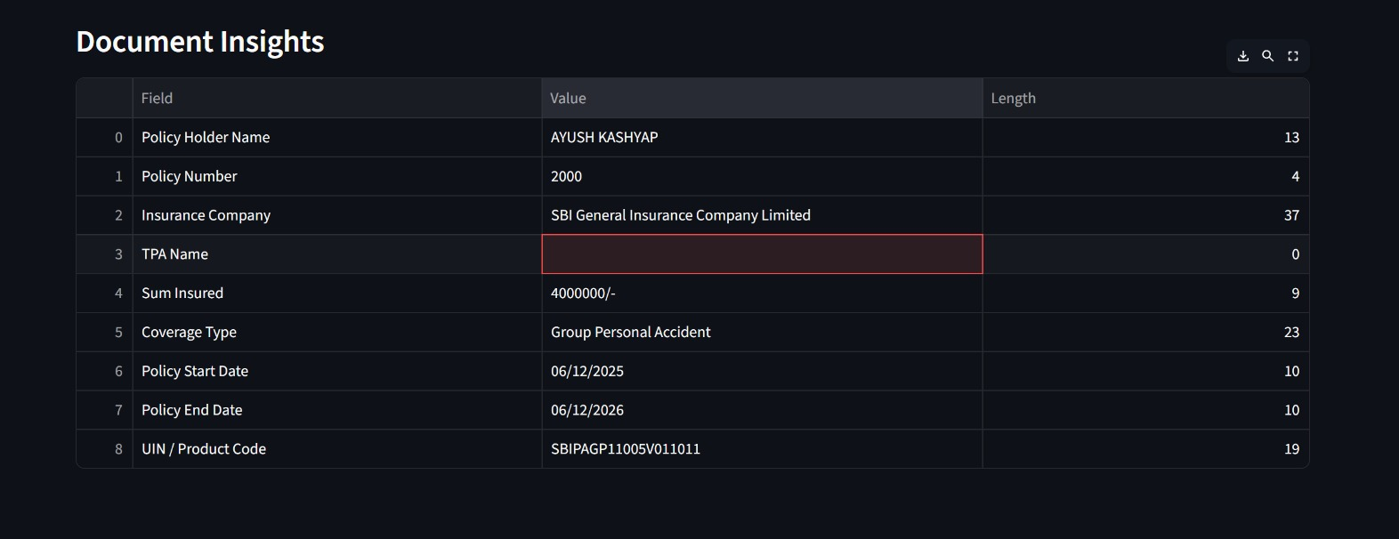
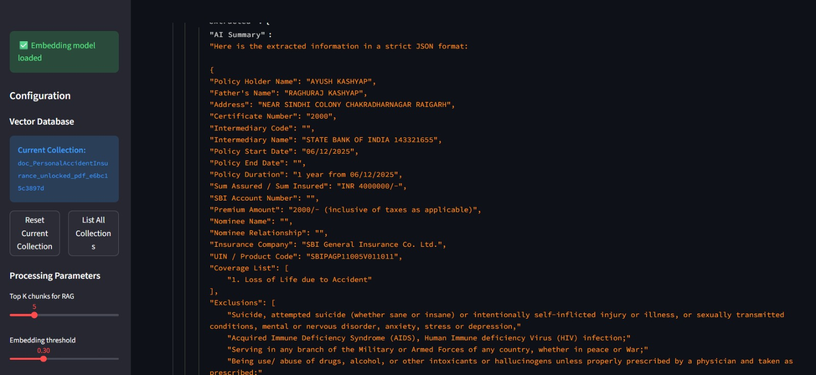

Slide 12
Results & Impact
Key Results from PoC:
Time Savings: The AI model reduced processing time per claim form by 75 - 80%, from 12 – 15 minutes.
Accuracy Improvement: Automated extraction showed an 80% reduction in errors compared to manual processing.
FTE Savings: Achieved a reduction of X Full-Time Equivalent (FTE) positions, resulting in
cost savings of time.
Key Business Metrics Impacted:
FTE Reduction: Significantly lowered headcount required for document processing.
Operational Efficiency: Faster processing of claims led to improved customer satisfaction and quicker decision-making.

Slide 13
Conclusion & Future Vision
Summary of Key Takeaways:
The AI-driven automation of document processing provides significant improvements in time efficiency, cost reduction, and accuracy.
The PoC demonstrates the feasibility and value of applying GenAI and NLP to automate insurance claims workflows.
Future Steps:
Scaling: Roll out the AI solution across all claim types, further optimizing workflows.
Continuous Improvement: Incorporate user feedback and data to refine the AI model and improve its explainability.
Exploring Additional Use Cases: Expand the AI solution to other sectors with similar document-heavy workflows, such as legal, healthcare, and banking.
Final Thought:
Embracing AI-powered automation in the insurance industry will not only reduce costs but also drive innovation, enabling companies to stay competitive in an increasingly digital world.

Slide 14
THANK YOU

